Slide 1
Modern Project Management
(Ch. 1 – T1)
M K Hamirwasia
WILPD

Slide 2
AE ZG523/DE ZG523/ES ZG523/MM ZG523/POM ZG523
Project Management
Second Semester 2024-25
Lecture No. 2

Slide 3



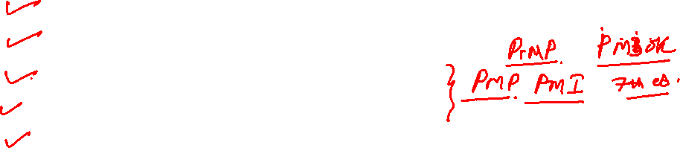
Introduction to Project Management
Definition of Project Management
Evolution of Project Management
Definition of a Project
Characteristics of a Project
The Project Life Cycle
Project, Program, Portfolio
Current Drivers of Project Management
The Project Manager
Project Management Process Groups
Project Management Knowledge Areas
Project Integration Management
Some Definitions

Slide 4
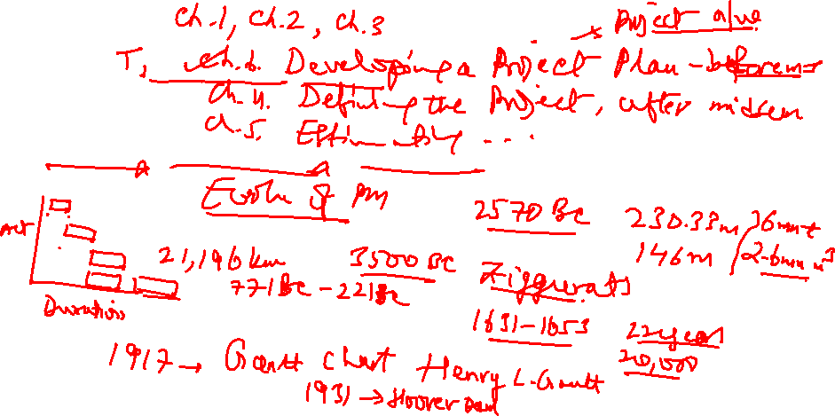


Slide 5
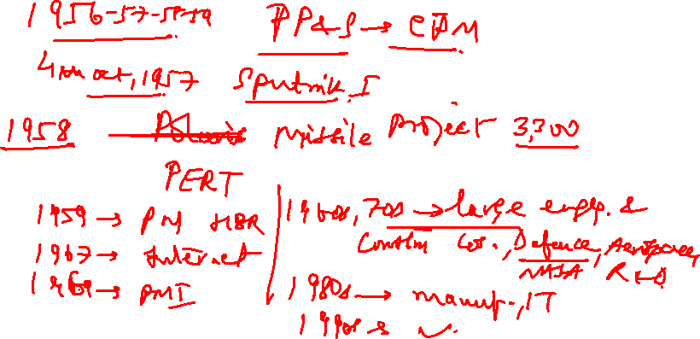

Slide 6
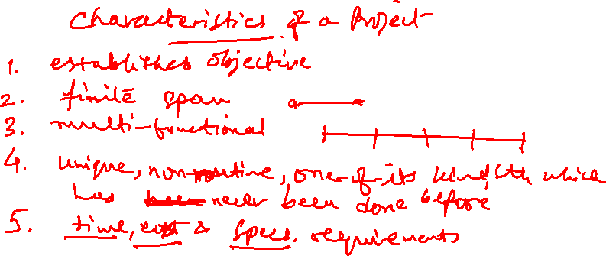

Slide 7
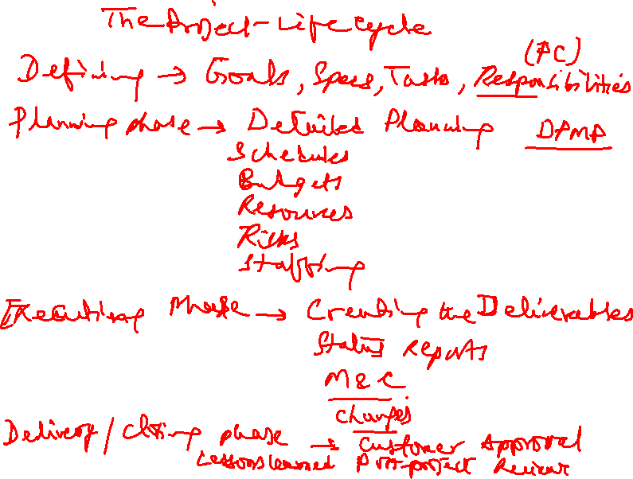

Slide 8
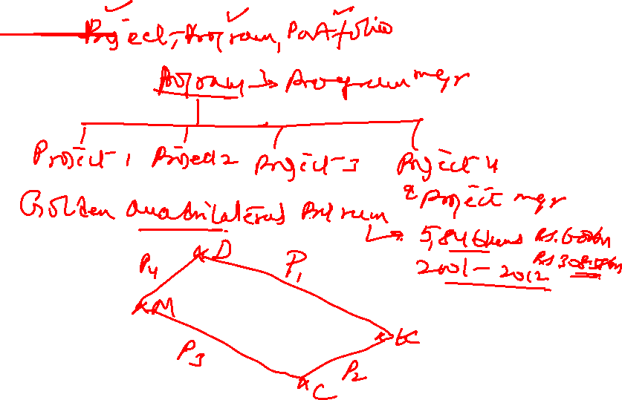

Slide 9
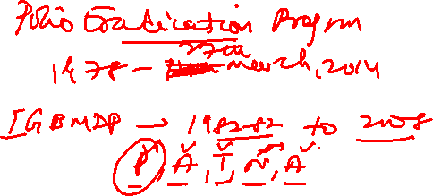

Slide 10
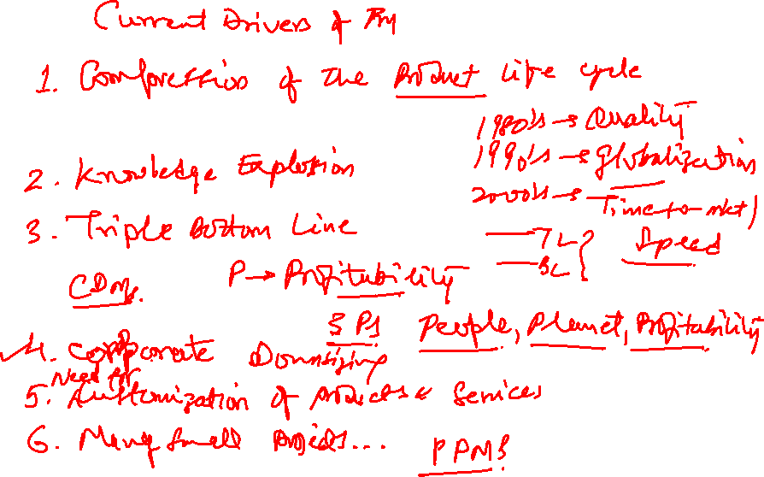

Slide 11
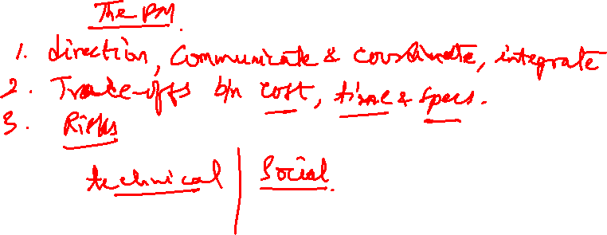

Slide 12
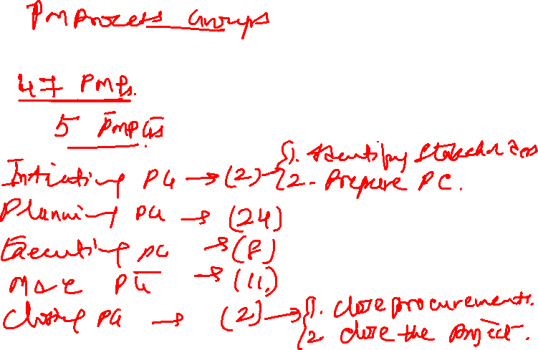

Slide 13
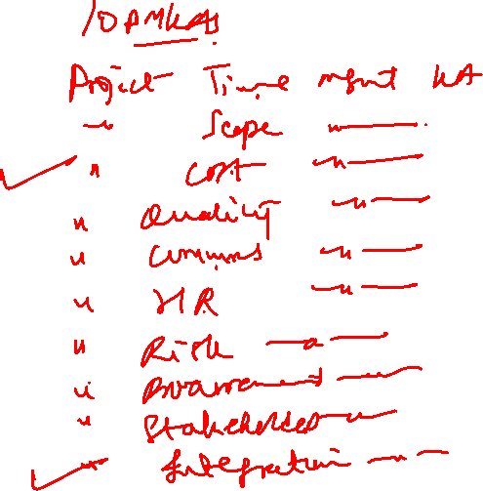

Slide 14
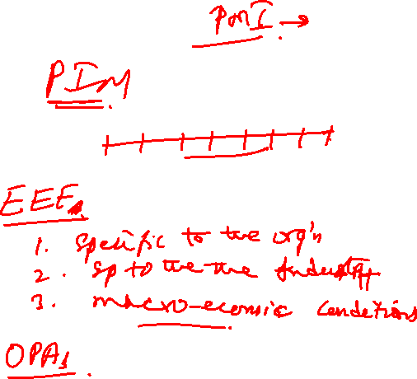

Slide 15
Introduction to Project Management
Basics
A project is a planned set of interrelated and sometimes dependent tasks that must be executed over a certain period of time taking into consideration certain costs, timelines, resources and other limitations. The tasks must be completed in order to reach a specific goal.
It can also be defined as a set of inputs and outputs needed to reach a specific outcome.
A project is an initiative, with a definite starting and ending point, that will result in a specific, unique outcome (product, service, solution or result). Once the desired result has been achieved, the project is complete.

Slide 16
Introduction to Project Management
Project management covers the management of projects and their running. Not all projects are the same and vary on a number of different elements that make each project individual.
Project Management is the application of knowledge, skills, tools and techniques to project activities to meet the project objectives for launching the project.
It is through certain project management processes that we apply the knowledge, skills, tools and techniques to project activities. Project management processes are supposed to embody good management practices common to management of almost all projects.

Slide 17
Intro to Project Management
Activities that go on indefinitely are typically known as processes or operations.
A project is unique; a process is repeatable and strives for consistency, standardization, and no deviation from a standard.

Slide 18
Introduction to Project Management
Project Scope: This describes the reach and scale of the project. Projects can be big or small depending on the scope.
A project’s scope is the full amount of work that needs to be performed in order to achieve the desired outcome under the given conditions.
The term scope creep refers to the uncontrolled expansion of a project’s scope, which can result in major delays and excessive costs.
Plan: A plan is a strategy designed to guide and control the project so that the desired result is achieved within the desired timeframe/cost.

Slide 19
Introduction to Project Management
Task: A task is a specific chunk of work or effort that needs to be completed in order to successfully execute the plan and achieve the desired result.
A resource is anything that is needed to complete/accomplish a project task. This includes people, equipment, materials, and other costs and expenses.
An assignment is the link between a resource and a task. In most cases, this means assigning a specific person to complete a specific chunk of work.

Slide 20
Introduction to Project Management
Projects are comprised of one or more phases. A phase consists of a group of activities that result in the completion of one or more deliverables (eg., the foundation phase of a house includes digging the trench, assembling the forms for the basement walls, pouring the concrete, etc.). Within each phase are various project management processes, which are grouped into five process groups: 1. Initiating Process Group, 2. Planning Process Group, 3. Executing Process Group, 4. Monitoring & Controlling Process Group, and 5. Closing Process Group.

Slide 21
The Project Charter vs Project Scope Statement
A project charter is a document issued by the project initiator/project sponsor/top management that formally authorizes the existence of a project and provides the project manager with the authority to utilize organizational resources for the completion of the project.
Ideally, a manager just one level above the project manager in the organization hierarchy should prepare the project charter. Else, the project manager should prepare the project charter. But it is issued by the senior management/project sponsor. Please note the difference between prepare and issue!

Slide 22
The Project Charter vs Project Scope Statement
The Project Charter (PC) and Project Scope Statement (PSS) can seem like one and the same sometimes. They are both usually contained early in the project management plan, and they both itemize the scope of the project to some extent.
Well, they have a slight difference in purpose. The PC should contain the rationale for the project, the reasons for its existence, who initiated it, and why. In other words, the core project foundation. The scope is very much a secondary function of the project charter.
The PSS tries to encompass the full scope of the project in a para or two.

Slide 23
The Project Charter vs Project Scope Statement
The following checklist can be used for a Project Charter:
The purpose and justification of the project.
Project objectives, or other success criteria.
High level requirements (something the product or service must do or a quality it must have).
Project description.
Product characteristics.
Risks.
Basic milestones.
Sample/preliminary budget.
Stakeholders.
Critical success factors.
Roles and responsibilities of PM and/or team.
Project sponsors, clients.

Slide 24
The Project Charter vs Project Scope Statement
The PSS can contain the following information:
Scope description.
Criteria for acceptance.
Project Deliverables.
Project Milestones.
Exclusions and constraints.
Project assumptions.
However, students may use the template given in Ch. 4 of the textbook.

Slide 25
Current Drivers of PM
Time-to-Market
Technological Complexity
Sustainable Development
Corporate Downsizing (Outsourcing)
Customer Responsiveness
Project Portfolio Management for managing many small projects

Slide 26
EVOLUTION and APPLICATION
Developed in the late 1950’s to aid planning and scheduling of large projects
Defence
Construction Industry
Aerospace
Automakers – Toyota, Nissan, BMW
Electronics
Information Technology
Steel & Cement
Fertilizer
Oil and Gas
Pharmaceutical

Slide 27
WHAT IS A PROJECT?
A Project is a Complex, Non-routine, One-time Effort Limited by Time, Resources and Performance Specifications Designed to Meet Customer Needs.
A Project is a Temporary Endeavour to Create a Unique Product, Service or Result.
EXAMPLES
  Introduction of a new kind of detergent in the market
  Enhancing the capacity of a plant
  Reducing the downtime of machines
  Improving the Quality of a Product
  Erection and Commissioning of a Power Plant
  Preparation of documents for takeover of a Firm
  Overhauling and Turnaround of an Oil Refinery

Slide 28
CHARACTERISTICS, ELEMENTS AND NEEDS
CHARACTERISTICS
  A Project consists of a series of activities and tasks that
  Have a Specific Objective to be Completed within Certain Specifications
  Have Definite Start and End Dates
  Have Funding Limits
  Consume Resources (human and non-human)
  Meet and Exceed Customer Needs
  Are Multifunctional - the Involvement of Several Departments and Professionals
  Typically Involve Doing Something That has Never been Done Before.

Slide 29
ELEMENTS OF A PROJECT
Project Selection
Prioritization Of Projects
Scope Of Work
Work Breakdown Structure
Risk Management
Cost and Time Estimate
Procurement
Allocation Of Resources
Execution Of Jobs

Slide 30
ELEMENTS OF A PROJECT
Subcontracting
Regular Review
Feedback
Control
Commissioning
Final Handing Over to the Client
Evaluation of Project Manager and Team
Retrospectives

Slide 31
NEED OF A PROJECT
Project: Fulfilling the needs and requirements of the Customer
Stakeholders: Meeting the needs of Stakeholders
Organization: Meeting the strategic needs of the organization
Individuals: Meeting the goals and aspirations of Project Manager and project team members

Slide 32
PROJECT DRIVEN ORGANIZATION Vs NON-PROJECT DRIVEN ORGANIZATION
Project Management in project-driven organizations is mature and respected. On the other hand, in non-project-driven organizations, Project Management is still in its infancy, and is often looked at with skepticism.
Project-driven organizations make the lion’s share of their income through projects; non-project-driven organizations mainly make their income through production.
The Project Manager is responsible for the profitability and loss in project-driven organizations. In non-project-driven organizations, the responsibility for profitability and loss is ambiguous.

Slide 33
PROJECT DRIVEN ORGANIZATION Vs NON-PROJECT DRIVEN ORGANIZATION
Project-driven organizations adopt either fully projectized or matrix organizational structures. Non-project-driven organizations usually adopt a functional organizational structure.
Project-driven organizations have flexible career paths, where one can ascend quickly to higher positions. Non-project-driven organizations have traditional career paths, where moving upwards in the company ladder is very difficult. Quite often, one has to wait for their manager to get fired/resign/retire/perish to ascend the company’s ladder and assume a better position.

Slide 34
PROJECT DRIVEN ORGANIZATION Vs NON-PROJECT DRIVEN ORGANIZATION
Examples of industries where project-driven organizations are predominant include:
Construction
Aerospace
Research
Examples of industries where non-project-driven organizations are predominant include:
Manufacturing
Services
Farming
Natural Resources

Slide 35
PROJECT DRIVEN ORGANIZATION Vs NON-PROJECT DRIVEN ORGANIZATION
IT (Information Technology) organizations (that fall under the services industry) are considered to be hybrid, where parts of such organizations are considered to be project-driven (such as the development of a new software), while other parts are considered to be non-project-driven (for example supporting applications).

Slide 36
LIMITATIONS OF NON-PROJECT DRIVEN ORGANIZATIONS
Projects may be few and far between
Not all projects have the same Project Management requirements
Executives do not have sufficient time to manage projects
Projects tend to be delayed because approvals most often follow vertical chain of command
Project staffing is on a local basis
Heavy dependence upon subcontractors and outside agencies for Project Management expertise

Slide 37
TYPES OF PROJECTS
Classification of Projects
Different Sectors: Public Sector, Private Sector, Service Sector, Joint Sector
Industrial
Software
Service
Infrastructure
Construction
Expansion
Modernization

Slide 38
Types of Projects
Maintenance
Plant Shutdown and Turnaround
Diversification
Integration
  Forward Integration
  Backward Integration
  Vertical Integration
Acquisition
Rehabilitation
Research and Development

Slide 39
WHY DO PROJECTS FAIL?
Inadequately trained and /or inexperienced project managers
Failure to set and manage expectations
Poor leadership at any and all levels
Failure to adequately identify , document and track requirements
Poor plans and planning processes
Poor effort estimation
Cultural and ethical misalignment

Slide 40
Why Do Projects Fail?
Misalignment between the project team and the business or other organizations it serves
Inadequate or misused methods
Inadequate communication , including progress tracking and reporting

Slide 41
PROJECT LIFE CYCLE
Project Life Cycle recognizes that projects have limited span
Predictable changes in level of effort and focus over the life of the project
Stages:
  Defining Stage
  Planning Stage
  Executing Stage
  Delivery / Closing Stage

Slide 42
Project Life Cycle
DEFINING
Goals
Specifications
Task
Responsibilities
PLANNING
Scheduling
Budgets
Resources
Risks
Staffing

Slide 43
Project Life Cycle
EXECUTING
Status Reports
Changes
Quality
Forecasts
CLOSING / DELIVERY
Train Customer
Transfer Documents
Release Resources
Evaluation
Lessons Learned

Slide 44
PRODUCT LIFE CYCLE
Research and Development
Market Introduction
Growth
Maturity
Deterioration
Death

Slide 45
LIFE CYCLE PHASES FOR DIFFERENT PROJECTS
Engineering
  Start Up
  Definition
  Main
  Termination
Manufacturing
  Formation
  Building
  Production
  Phase-out
  Final Audit

Slide 46
LIFE CYCLE PHASES FOR DIFFERENT PROJECTS
Software Development
  Conceptual
  Planning
  Definition and Design
  Code
  Integration / Testing
  Conversion
  Maintenance
Construction
  Planning, Data Collection and Procedures
  Studies and Basic Engineering
  Major Review
  Detailed Engineering
  Construction
  Testing and Commissioning

Slide 47
The Project Manager
A project manager is a person who has the overall responsibility for the successful initiation, planning, design, execution, monitoring, controlling and closure of a project. Construction, petrochemical, architecture, information technology and many different industries that produce products and services use this job title.
The project manager must have a combination of skills including an ability to ask penetrating questions, detect unstated assumptions and resolve conflicts, as well as more general management skills.
Key among a project manager's duties is the recognition that risk directly impacts the likelihood of success and that this risk must be both formally and informally measured throughout the lifetime of a project.

Slide 48
The Project Manager
Risks arise from uncertainty, and the successful project manager is the one who focuses on this as their primary concern. Most of the issues that impact a project result in one way or another from risk. A good project manager can lessen risk significantly, often by adhering to a policy of open communication, ensuring every significant participant has an opportunity to express opinions and concerns.
A project manager is a person who is responsible for making decisions, both large and small. The project manager should make sure they control risk and minimize uncertainty. Every decision the project manager makes must directly benefit their project.

Slide 49
The Project Manager
Roles and Responsibilities
The role of the project manager encompasses many activities including:
Planning and Defining Scope
Activity Planning and Sequencing
Resource Planning
Developing Schedules
Time Estimating
Cost Estimating
Developing a Budget
Documentation
Creating Charts and Schedules

Slide 50
The Project Manager
Risk Analysis
Managing Risks and Issues
Monitoring and Reporting Progress
Team Leadership
Strategic Influencing
Business Partnering
Working with Vendors
Scalability, Interoperability and Portability Analysis
Controlling Quality
Benefits Realization
Finally, senior management must give a project manager support and authority if he or she is going to be successful.

Slide 51
Being Part of a Project Team
Team members are selected because they have particular skills that are required to complete project tasks. Examples include specialists in business or technical disciplines, or an outside supplier.
The Team Member’s role is to successfully perform the tasks that have been allocated, keeping the project manager informed of progress as well as any issues that may arise.
The role often requires team members to work on their own initiative in areas where they are the ‘experts’. This places the responsibility on them to manage their own day to day work, recognize the authority of the Project Manager and report to the Project Manager as appropriate.

Slide 52
Being Part of a Project Team
Team membership often changes as a project moves through its development. This means there are frequently two types of team member:
Core Team Member - a full time role on the project but not necessarily for the duration of the project.
Extended Team Member - a part time role on the project . These team members will usually have their regular job to do, or they may be from an outside company.
Part of the Team Member’s role is to pay attention to the problems others may be facing. Tolerance and good communications are essential ingredients of successful project teams.

Slide 53
Being Part of a Project Team
The responsibilities assigned to individual team members may vary but typically will include:
understanding the purpose and objectives of the project
ensuring a correct balance between project and non-project work
working to timescales and within cost constraints
reporting progress against plan
producing the deliverables/products to agreed specifications
reviewing key project deliverables/products

Slide 54
Being Part of a Project Team
identifying issues
identifying risks associated with the project
working together as a team
contributing towards successful communication
contributing towards positive motivation
On small or specialized projects, the Team Member may also be the Project Manager.

Slide 55
PIM
Project Integration Management is a collection of processes required to ensure that the various elements of the projects are properly coordinated. It involves making trade-offs among competing objectives and alternatives to meet or exceed stakeholder needs and expectations.
In other words, Project Integration Management process comprises of activities like identifying, defining, combining, and coordinating various processes related to project.

Slide 56
L2 - Modern Project Management
Second Semester 2024-25 (S2-24)
Thank You!
M K Hamirwasia
hamirwasiamk@pilani.bits-pilani.ac.in

